Slide 1
Gypsum Belt-Filter Cake Recognition
Automated valid / invalid detection from a plant camera feed
AI Expert — Final Project
Yaron Conroy
2026-09-23
Code: github.com/yaronconroy-del/picture-recognition-gypsum (private — access arranged on request)
1

Slide 2
B. PROJECT IDEA
Problem Statement
▪ A fixed camera watches a gypsum belt filter on a phosphoric-acid production line.
▪ Filtration quality is currently checked by manual visual inspection — intermittent, and inconsistent between operators/shifts.
▪ Goal: an image classifier that looks at a single camera frame and tells whether the cake is VALID (properly dewatered) or INVALID (wet gypsum), automatically and continuously.
▪ This is a proxy for a real yield-loss and equipment-damage problem, not a cosmetic visual check (see next slides).
Evaluation & Docs/Project Workflow.md §1
2

Slide 3
C. BACKGROUND & MOTIVATION
Background: the Process
▪ Wet-process phosphoric acid production:
– Phosphate rock + sulfuric acid → phosphoric acid + gypsum (by-product)
▪ Gypsum still carries residual phosphoric acid.
▪ It's washed with water, then dewatered on the belt filter this project's camera watches — to recover as much phosphoric acid as possible before the gypsum is discarded.
▪ “Invalid” = wet gypsum: the cake didn't dewater properly.
Rock + H₂SO₄
↓
Phosphoric acid + Gypsum (wet)
↓ wash with water
↓ belt filter (dewater)
Dry cake → recovered acid | Wet cake → lost acid
Evaluation & Docs/Project Workflow.md §1.2
3

Slide 4
C. BACKGROUND & MOTIVATION
Background: the Cost of Bad Filtration
▪ Wet gypsum causes two separate costs:
– Yield loss — unrecovered phosphoric acid, lost with the discarded gypsum: ~$2,000/hour per 1% P₂O₅ remaining
– Equipment damage — wet gypsum can damage downstream equipment, adding downtime
Yield-loss rate | $2,000/hr per 1% P₂O₅ → ~$6,000/hr at a typical ~3% equivalent
Yield-loss exposure | ~480 hr/yr affected (6% of ~8,000 hr/yr) → ~$2,880,000/year
Downtime rate (equipment damage) | $49,500/hr (45 × 1,100)
Downtime exposure | ~240 hr/yr affected (3% of ~8,000 hr/yr) → ~$11,880,000/year
Combined annual exposure | ~$14,760,000/year
Automated-detection recovery (10–15%) | ~$1,476,000 – $2,214,000/year
Assumptions stated explicitly — swap in real annual operating hours for exact figures.
Evaluation & Docs/Project Workflow.md §1.2
4

Slide 5
C. BACKGROUND & MOTIVATION
Related Work
▪ Transfer learning from ImageNet-pretrained CNNs is standard for small industrial inspection datasets — used in 83% of studies in a 2024 review of CNN-based surface-defect detection.
– This project follows that pattern: MobileNetV2, transfer-learned, not trained from scratch.
▪ Class imbalance between “normal” and “defect” is treated as the norm in this literature — defects are genuinely rarer than normal output.
– This project's “empty” class (8 of 176 images, 4.5%) sits in the same range; class-weighted loss is the standard mitigation, which this project uses.
▪ Published benchmarks reach 95%+ accuracy — but on datasets one to three orders of magnitude larger than this project's 176 images.
– This project's ~77% CV accuracy should be read against that gap, not against best-case published numbers.
Evaluation & Docs/Project Workflow.md §1.1
5

Slide 6
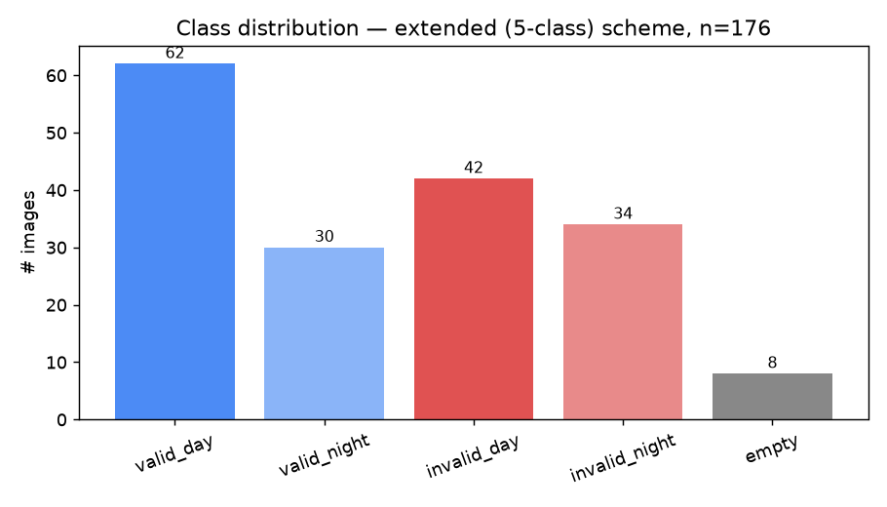
D. METHODOLOGY
Dataset
▪ 176 photos total, from the plant's own camera (via WhatsApp export).
▪ 5 native classes: valid/invalid × day/night, plus empty filter.
▪ Randomized filenames + a manifest for traceability, not sequential/revealing names.
▪ Real capture-session timestamps recovered from the manifest — used for leakage-safe splitting (next slide).
▪ IT/data-access constraints limited the photos available for this phase — a full-scale pilot would use a much larger database (§16.2).
Evaluation & Docs/Project Workflow.md §3, §3.5
6

Slide 7
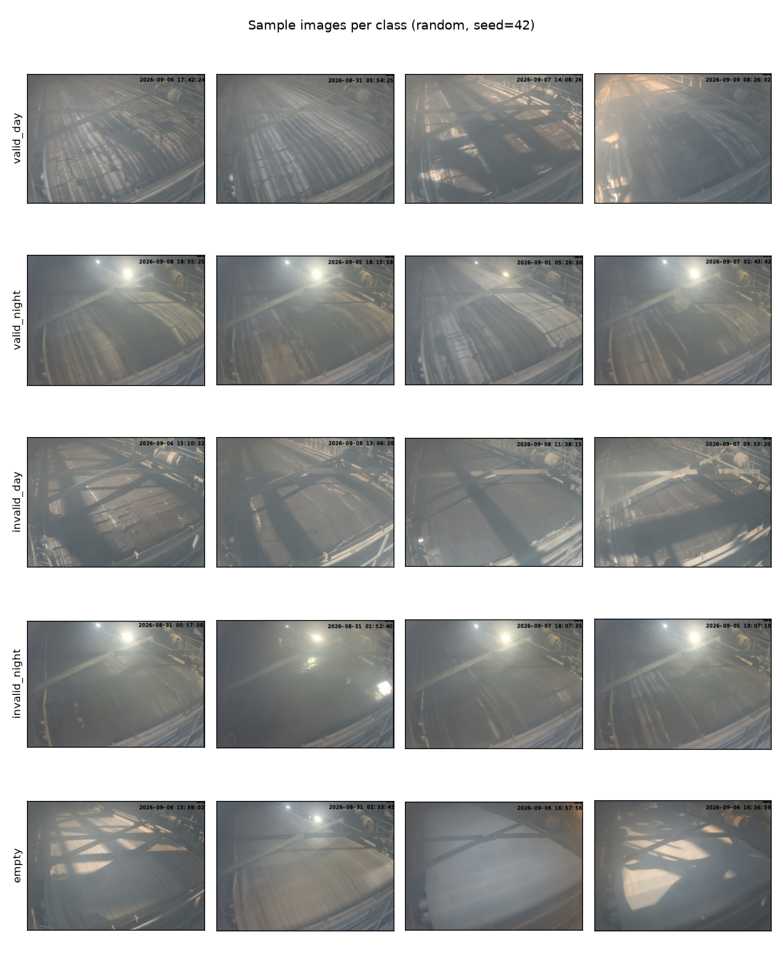
D. METHODOLOGY
Dataset — What the Camera Actually Sees
Model & Training/eda/sample_grid.png — random samples, seed=42
7

Slide 8
D. METHODOLOGY
Preprocessing & Modeling Approach
▪ Timestamp overlay masked out (top strip) so the model can't key off the burned-in clock.
▪ Leakage-safe splits by real capture session (not per-image) — photos seconds apart don't leak across train/test.
▪ Three split ratios tested (80/20, 75/25, 70/30) plus K-fold cross-validation, auto-capped per scheme to what the scarcest class's session count actually supports.
▪ Model: MobileNetV2 (52 conv layers, ImageNet-pretrained) — transfer learning, not training from scratch (§1.1).
– Only the last block + new classifier are unfrozen; the rest stays at pretrained weights — 176 images can't support fully fine-tuning 3.4M parameters without overfitting. A larger database would support unfreezing more (§16.3).
▪ Class-weighted CrossEntropyLoss for imbalance; a WeightedRandomSampler variant was also tried.
▪ One fixed config (backbone, lr=1e-3, 10 epochs) held constant across every comparison, so only one variable changes at a time.
Evaluation & Docs/Project Workflow.md §4, §5
8

Slide 9
E. EXPERIMENTS & RESULTS
Experiment 1: Which Label Scheme?
Cross-validation accuracy (the trustworthy number — averaged over independent sessions):
Scheme | CV Accuracy | Invalid Recall
Lite (3-class: valid/invalid/empty) | 63.3% ± 9.5 | 42.4% ± 1.9
Extended (5-class: + day/night) | 72.3% ± 0.5 | 63.9% ± 7.5
No-empty collapsed (2-class) | 70.8% ± 14.3 | 57.7% ± 26.7 (unstable)
No-empty split (4-class) | 77.4% ± 1.9 | 71.1% ± 5.4
▪ Extended (5-class) beat Lite on every ratio and in CV — day/night carries real signal.
▪ No-empty split (4-class) beat every scheme tried — folding “empty” into “invalid” measurably helps, not just simplifies.
▪ No-empty collapsed's high single-split numbers are not trustworthy — its CV variance is enormous (±14.3 points).
Evaluation & Docs/Project Workflow.md §6, §8
9

Slide 10
E. EXPERIMENTS & RESULTS
Decision: No-Empty Split (4-class)
▪ Compared fairly (same ground-truth definition, same run): no-empty split wins on every metric vs. extended — accuracy, invalid recall, ROC AUC (0.852 vs. 0.808), PR AP (0.805 vs. 0.769).
▪ Beyond the numbers — the operational argument is stronger:
– The empty-filter dataset is tiny (8 of 176 images).
– A live model doesn't need to detect “empty” at all — the operator empties the filter themselves and already knows it.
– Production design: toggle the model off during that operator-controlled window, back on once filtration resumes.
Classes: valid_day · valid_night · invalid_day · invalid_night
Evaluation & Docs/Project Workflow.md §12
10

Slide 11
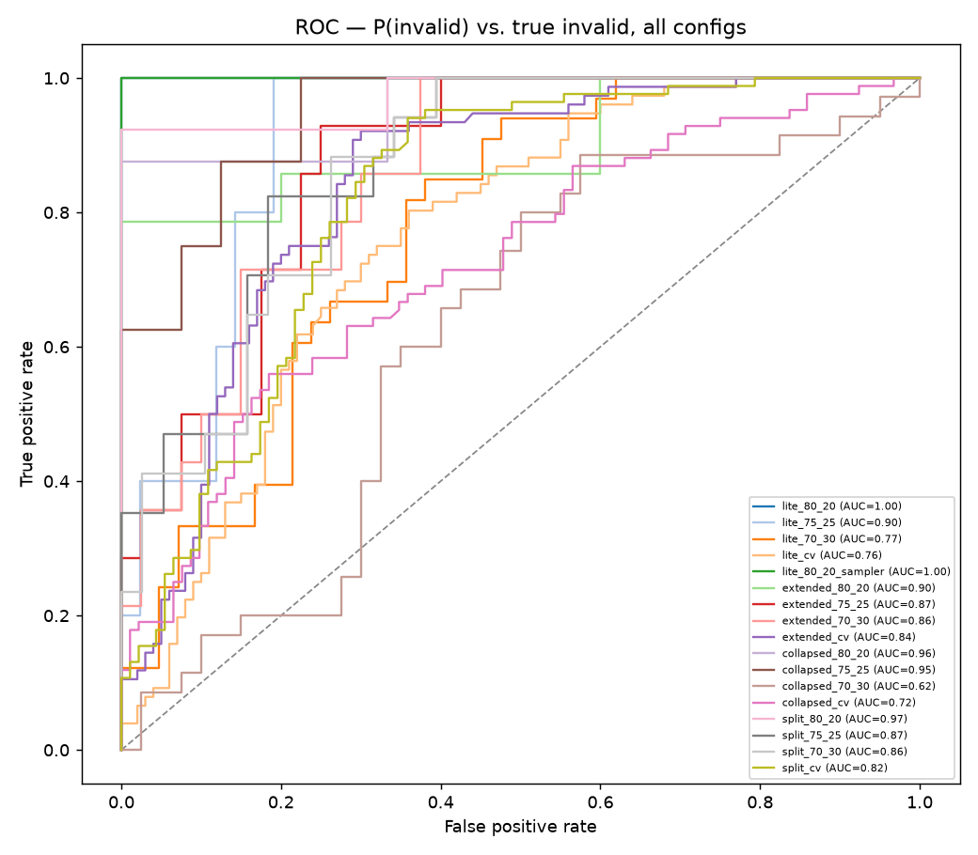
E. EXPERIMENTS & RESULTS
Experiment 2: Tuning the Decision Threshold
▪ Every training run so far decided valid-vs-invalid with a bare argmax() — an untuned, implicit 0.5 cutoff.
▪ Re-analyzed all 23 configs with full probabilities: ROC/AUC, precision-recall/AP, calibration, and two threshold candidates (Youden's J; F1-optimal).
▪ Finding: the default 0.5 cutoff was under-flagging real faults — nearly every config's optimal threshold is below 0.5.
▪ No-empty split CV: F1-optimal threshold = 0.466, close to 0.5.
▪ Extended CV: F1-optimal threshold = 0.302 — well below 0.5.
Evaluation & Docs/Project Workflow.md §9
11

Slide 12
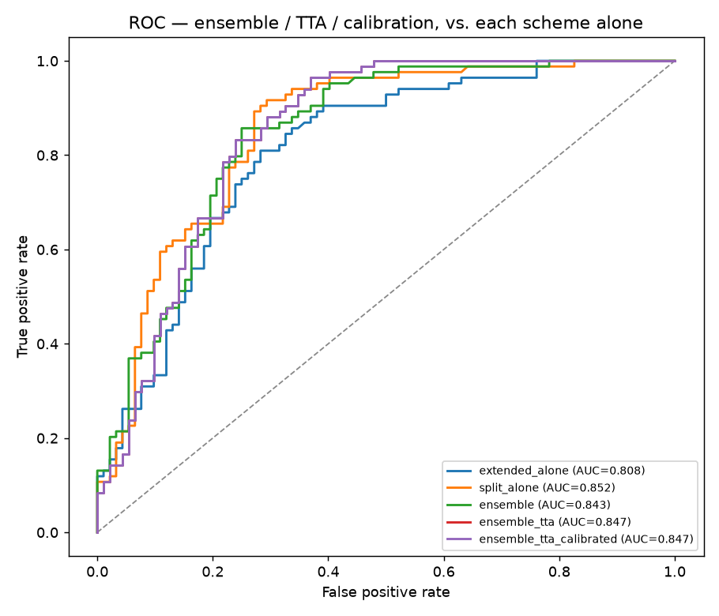
E. EXPERIMENTS & RESULTS
Experiment 3: Pushing Further (a Negative Result)
Variant | ROC AUC | PR AP
Extended alone | 0.808 | 0.769
No-empty split alone | 0.852 | 0.805
Ensemble (avg. of both) | 0.843 | 0.803
+ Test-time augmentation | 0.847 | 0.787
+ Calibration | 0.847 | 0.787
▪ Tried: ensembling extended + no-empty split, test-time augmentation, Platt-scaling calibration.
▪ None beat the single best model — reported straight, not spun.
▪ A plain average pulled the stronger model down toward the weaker one.
Evaluation & Docs/Project Workflow.md §10
12

Slide 13
D. METHODOLOGY / E. RESULTS
Live Demo Scripts
▪ predict.py — classifies one photo from the command line: predicted class, confidence, and a VALID/INVALID call.
– Auto-selects the best available trained model; “empty” predictions count as INVALID, matching the §12 decision.
– Spot-checked on 3 sample photos: 2/3 correct at high confidence; the one miss landed on the model's documented weak spot (the empty class).
▪ watch_camera_feed.py — simulates the live feed: watches a folder, classifies each new photo within seconds, prints an ALERT line for INVALID.
– A stand-in for a real camera connection — tested locally with a valid and an invalid sample photo, both classified and flagged correctly.
▪ Both reuse the exact same preprocessing as training — no drift between what was evaluated and what runs live.
Evaluation & Docs/Project Workflow.md §13, §14
13

Slide 14
F. CONCLUSIONS, LIMITATIONS & DIRECTIONS
Conclusions
▪ No-empty split (4-class) is the strongest model found — ~77% CV accuracy, ROC AUC 0.852, clearly ahead once compared fairly.
▪ Folding “empty” into “invalid” is both statistically and operationally correct, not just a simplification.
▪ The default 0.5 threshold was under-flagging real faults — tuned thresholds catch more real invalid cases.
▪ Ensembling/TTA/calibration did not beat the single best model — an honest negative result.
▪ Business case: automated detection is estimated to recover ~$1.48M–2.21M/year (10–15% of ~$14.76M/year combined yield-loss + downtime exposure).
Evaluation & Docs/Project Workflow.md §16.1
14

Slide 15
F. CONCLUSIONS, LIMITATIONS & DIRECTIONS
Limitations
▪ Small dataset by IT constraint, not choice — 176 images (8 “empty”); every number carries real uncertainty.
▪ Single seed, mostly CPU-trained runs.
▪ The promoted model hasn't had a real full training run yet — full_pipeline.ipynb still needs to run in Colab for real.
▪ Day/night remains unexplained — ruled out literal time-of-day and whole-image brightness, but the real cause is still unknown.
▪ The live-feed demo is a simulation (folder-watcher), not a real camera/RTSP integration or real alerting channel.
▪ Single fixed camera, uncontrolled lighting; source images are WhatsApp-recompressed, not native resolution.
Evaluation & Docs/Project Workflow.md §16.2
15

Slide 16
F. CONCLUSIONS, LIMITATIONS & DIRECTIONS
Further Directions
Near-term
▪ Run full_pipeline.ipynb for real to get trustworthy final numbers and the actual promoted weights.
▪ Confidence-weighted ensembling instead of a plain average; build the real camera feed + alerting channel.
Full-scale pilot (plant engineer's roadmap)
▪ Retrain on a much larger database once IT/data-access constraints are lifted, and unfreeze more of the backbone (today's last-block-only fine-tuning is a dataset-size-driven choice, not a ceiling).
▪ Add projectors around the filter to normalize day/night lighting and reduce shadow effects — engineers the day/night ambiguity away at the source.
▪ Move beyond binary valid/invalid to a continuous filtration-quality score, so the process trend is visible.
▪ Make it a time-based model that tracks change over a sequence of frames and flags the process turning bad — early warning, not single-frame classification.
▪ Far future: a downstream model that calculates the right reactor process parameters from the predicted filtration state — closing the loop from vision to process control.
Evaluation & Docs/Project Workflow.md §16.3
16

Slide 17
Thank you
Questions?
Code: github.com/yaronconroy-del/picture-recognition-gypsum
17

